Slide 1
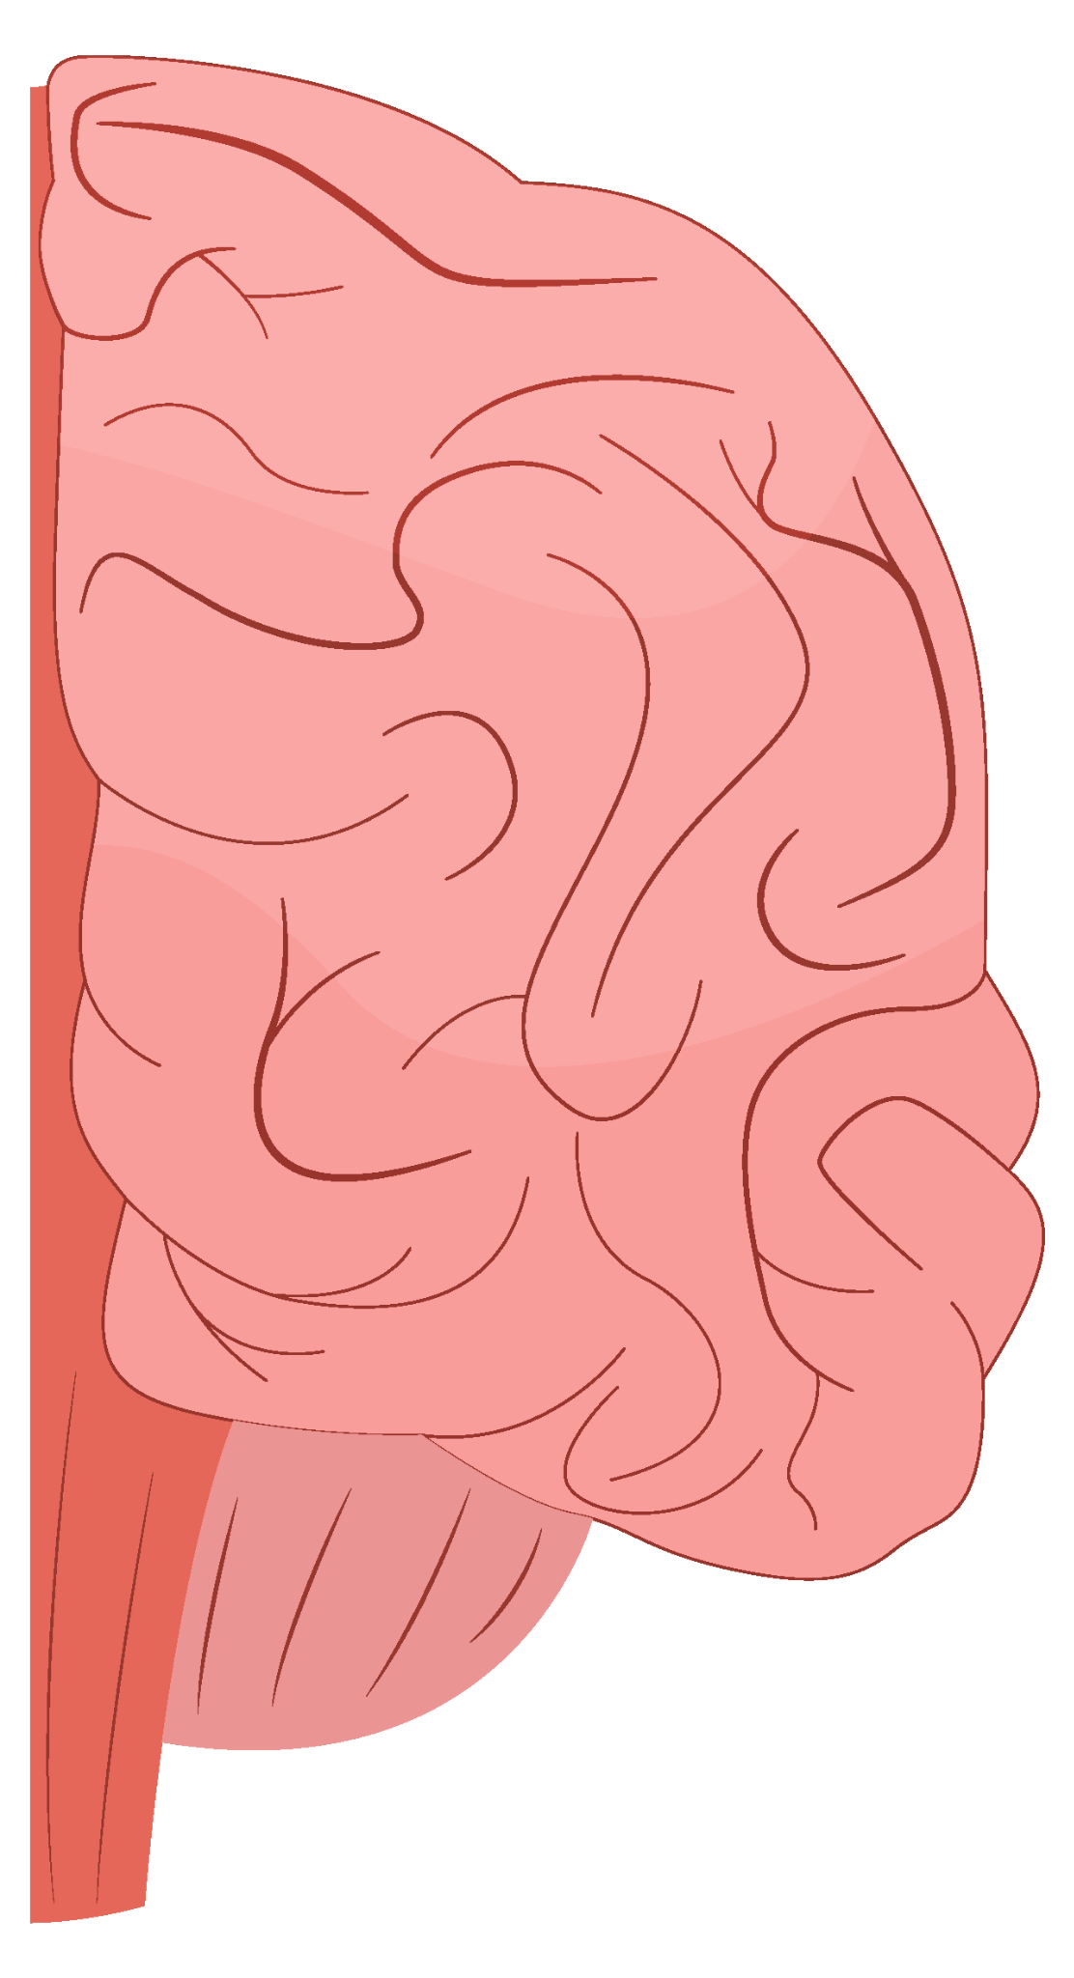
Stress detection and analysis depi graduation project
Members:
Abd ElRahman Ashraf
Ahmed Fraig
Omar Khalifa
Tasneem Mahmoud
Esraa Mamdouh Omar
Under the supervision of :

Slide 2
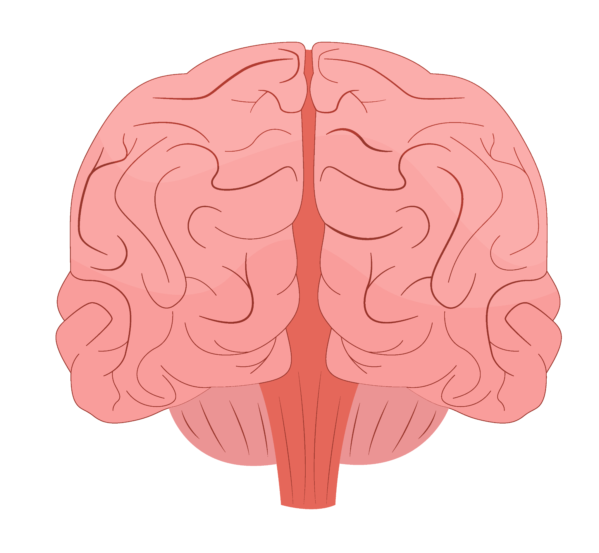
Table of contents
01
02
03
04
05
06
Overview and objectives
Literature review
Project summary
Results
Conclusion
References

Slide 3
01
Overview and objectives

Slide 4
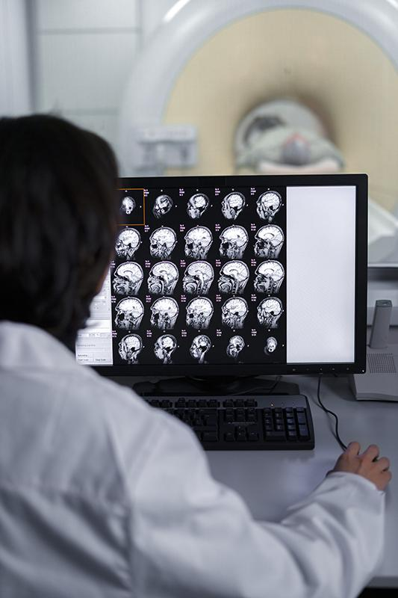
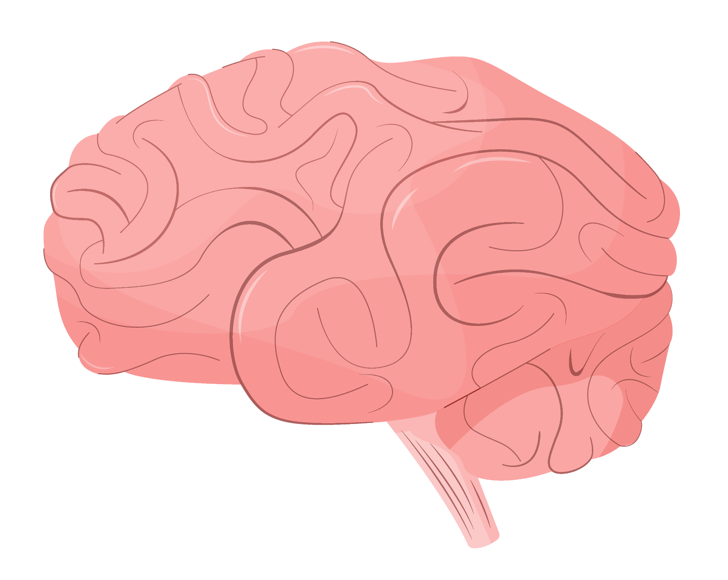
Overview
This project focuses on Stress Detection and Analysis using EEG (Electroencephalogram) and ECG (Electrocardiogram) data.
The goal is to preprocess this data and use it for developing machine learning models that can classify stress levels in individuals. We are leveraging Azure services for storage, computation, and model development.
Technologies Used:
- Azure Services: For storage and computation.
- Databricks: For data analysis and preprocessing.

Slide 5
Objectives
Develop Machine Learning Models for Stress Detection
Build models using EEG and ECG data to classify stress levels accurately.
Improve Mental and Physical Well-being
Provide insights to help individuals manage stress effectively.
Allow use in several applications such as lie detectors
By measuring stress levels, we can reach several conclusions such as figuring out if the person is lying.
Support Decision-Making in High-Stress Environments
Assist professionals like athletes, healthcare workers, and corporate employees in managing stress.
Promote Scalability and Practical Use
Design solutions that can be easily adopted across various industries and environments.

Slide 6
02
Literature review

Slide 7
Literature review
Paper Title: ECG and EEG based detection and multilevel classification of stress using machine learning for specified genders: A preliminary study
Key Findings on Gender Differences:
Objective: Explore how gender influences stress detection accuracy using physiological signals.
Women:
- During the luteal phase, lower estrogen levels result in higher stress, improving model accuracy.
Men:
-Show wider stress gaps between low and high stress levels, facilitating better classification accuracy.

Slide 8
Literature review
Machine Learning Models and Practical Applications:
Binary Stress Detection:
ECG-based models showed 79.81% accuracy for females and 73.77% for males.
Multilevel Stress Classification:
- Combining ECG and EEG signals improved accuracy to 62.60% for females and 71.57% for males.
The stacking technique outperformed individual models for both genders.
Practical Recommendations:
- ECG-only models are ideal for personal use.
- Combined ECG & EEG models are better for clinical applications.
- Gender differences must be considered to ensure accurate stress classification

Slide 9
Data set overview
ECG and EEG Stress Dataset Overview
Participants: 40 university students (21 females, 19 males)
Signals Recorded:
ECG: Heart rate variability (HRV) features
EEG: Brain activity across 7 frequency bands (8 electrodes)
Experimental Setup:
EO (Baseline): Rest (5 min)
AC1 (Low Stress): Math tasks (quiet environment)
AC2 (High Stress): Math tasks with audio distraction
Data Files:
ECG and EEG feature data for all stress levels
Alpha & Beta power ratios (relative EEG)

Slide 10
03
Project Summary

Slide 11
Key components
1. Azure Blob Storage:
Storage Setup
Security
Containers:
raw-data: Original EEG and ECG files.
processed-data: Cleaned and organized data for analysis.
OAuth 2.0 authentication.
Environment variables for credentials.
Docker for consistent deployment across environments.
2. Data Mounting in Databricks:
Mount points
Direct access to data via mounted containers.
/mnt/stressdata (raw data)
/mnt/processedstressdata (processed data)

Slide 12
Data preprocessing
Data types
Processing steps
Cleaning and merging datasets.
Exporting processed data back to Azure Blob Storage.
Calculation of Alpha and Beta power ratios in EEG.
ECG Data: Metrics on heart rate variability.
EEG Data: Brainwave frequency analysis (Delta, Theta, Alpha, Beta, Gamma).
Access to Scripts:
Preprocessing code available in the project repository.

Slide 13
SQL Queries and Managment
Purpose: Efficient data storage and retrieval in the database.
Components:
Create Tables: SQL queries for ECG and EEG data.
Create Schemas: Organizing data for better management.
Stored Procedures: Automate data insertion and table creation.
Inserting Data: Populate tables with preprocessed data.
Access to SQL Scripts:
Available in the project’s SQL Queries folder.

Slide 14
04
Results

Slide 15
Overall Results - All Genders
Without RFE:
Improved Binary Classification Accuracy: 83.3%
Improved Binary Classification F1 Score:
87.5%
With RFE (EO vs AC1 vs AC2):
Improved Binary Classification Accuracy:
91.7%
Improved Binary Classification F1 Score:
93.6%

Slide 16
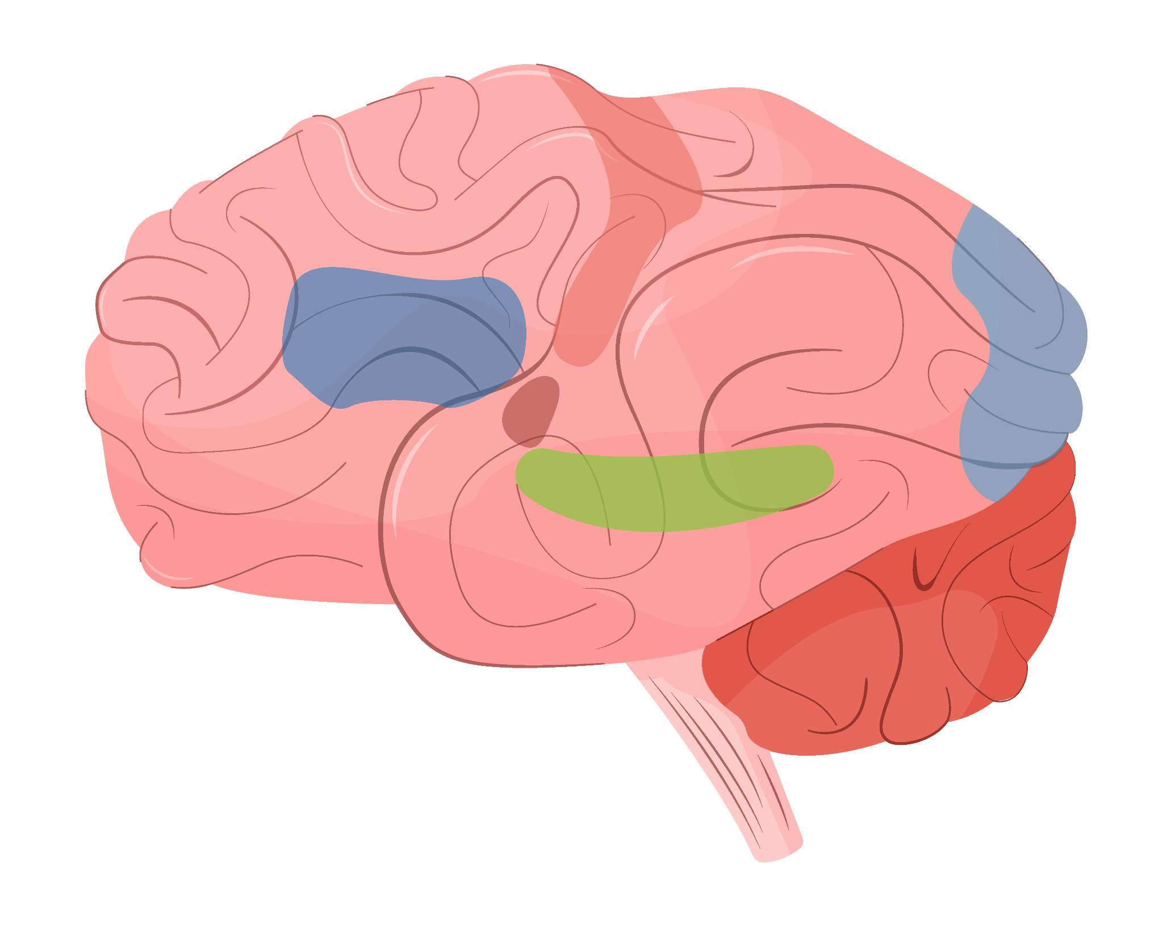
Classification Performance All Genders EO vs AC1:
87.50%
69.57%
Accuracy
F1 score

Slide 17
Classification Performance All Genders EO vs AC2:
87.50%
85.71%
Accuracy
F1 score

Slide 18
Selected Features by RFE
Features Identified:
Mean HR (BPM)
pNN50 (%)
HF Norm (n.u.)
Fp1_Theta (4-8 Hz)
Fp2_Theta (4-8 Hz)
F3_Alpha (8-12 Hz)
F4_Alpha (8-12 Hz)
P4_Alpha (8-12 Hz)
F3_Beta 2 (20-30 Hz)
Fp1_Gamma (30-60 Hz)
P4_Gamma (30-60 Hz)
Fp1_Gamma 2 (60-100 Hz)
Beta1_(Fp 1 - Fp 2)
Beta1_(T 3 - T 4)
Beta1_(P 3 - P 4)
Distribution of Features:
ECG Data: 3 features
EEG Data: 9 features
Ratio of Alpha/Beta Power Data: 3 features

Slide 19
Gender-based Model Performance
Male Model:
-Accuracy with RFE: 50.00%
-F1 Score with RFE: 66.67%
Female Model:
-Accuracy with RFE: 84.21%
-F1 Score with RFE: 86.96%
EO vs AC1 Performance:
Male:
Accuracy: 58.33%
F1 Score: 28.57%
Female:
Accuracy: 92.31%
F1 Score: 90.91%

Slide 20
Gender based model performance accuracy EO vs AC2:
92.31%
83.33%
Female
Male

Slide 21
05
Conclusion

Slide 22
Conclusion
Improved Binary Stress Detection:
RFE-enhanced models showed improved performance across both genders.
Highest improvement observed in EO vs AC2 performance, especially for females (Accuracy: 92.31%).
Gender Differences:
Female models consistently outperformed male models, highlighting potential gender-specific physiological differences in stress response.
The male model showed moderate improvements (83.33% accuracy in EO vs AC2) but remained lower than female results.
EEG and ECG Contribution:
Most important features came from EEG signals, showing their significance in stress detection.
Combining ECG and EEG data led to better outcomes than ECG-only models from previous studies.
Key Takeaway:
The research demonstrates the effectiveness of using combined signals and feature selection techniques like RFE to boost stress detection accuracy, especially in gender-specific contexts.

Slide 23
06
Refrences

Slide 24
Refrences
Apit Hemakom, Atiwiwat, D., & Pasin Israsena. (2023). ECG and EEG based detection and multilevel classification of stress using machine learning for specified genders: A preliminary study. PLOS ONE, 18(9), e0291070–e0291070. https://doi.org/10.1371/journal.pone.0291070
Data set:
ApitHm. (2023). ECG&EEG Stress Features. Kaggle.com. https://www.kaggle.com/datasets/apithm/ecg-and-eeg-stress-features
Github project link:
https://github.com/AbdelrahmanAboegela/Depi-Graduation-Project
‌

Slide 25
Thanks
Got a question? Don’t hesitate to contact us
https://github.com/AbdelrahmanAboegela
https://github.com/ahmedfraig
https://github.com/OmarKhalifa360
https://github.com/TasnemMahmoud
https://github.com/EsraaMamdouh1

